Slide 1
Exploratory analysis of IOT data
Presented By:
Parul Verma

Slide 2
Contents
Introduction
Problem Statement
Datasets
Analysis & Implementation
Dashboard

Slide 3
Introduction
Several IOT devices in total 73 rooms in DC, UWaterloo.
Dataset includes data from these IOT sensors for every 30 sec over a period of 4 months.
Technology Stack:
  D3.js – Initial plots
  Spark – Aggregating data over 10 min window
  MatPlotlib – Plotting the new aggregated data
  Python – Converting the dataset to common timestamp
  Machine Learning – Find similarities between the rooms
  Microsoft Excel Power View – Manual analysis of the plots
  dyGraph – Display the results using dashboard

Slide 4
Problem Statement
Bigger Picture: Aim is to use the electronic equipment in rooms efficiently based on the usage pattern.
Categorize the rooms into 3 groups:
  Staff
  Faculty
  Student
Identify the usage pattern based on these categories.

Slide 5
Datasets
Motion: standard deviation observed by motion sensors
  Format – Timestamp, Motion SD, DeviceId
Occupancy: computer occupancy from motion sensors
  Format – Timestamp, Occupancy, DeviceId
State: state of the device(heating/cooling) and fan speed
  Format – Timestamp, Heat, Cool, Fan Speed, DeviceId
Temperature: Temperature of the room
  Format – Timestamp, Temperature, DeviceId

Slide 6
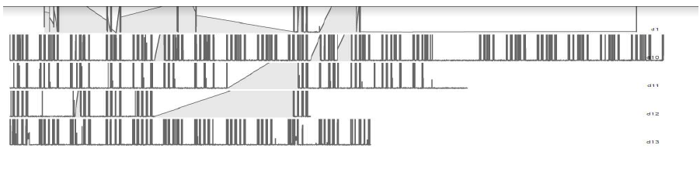
Analysis and Implementation
Step 1:
  Plotted data using d3.js
  Browser crashed because size of the data was too large

Slide 7
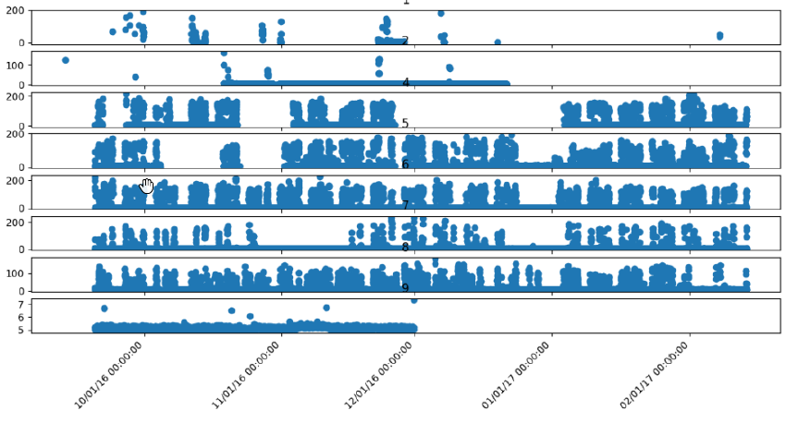
Analysis and Implementation
Step 2:
  Aggregated data over 10 min window using Spark to reduce the data size.
  Plotted data using MatPlotlib.

Slide 8
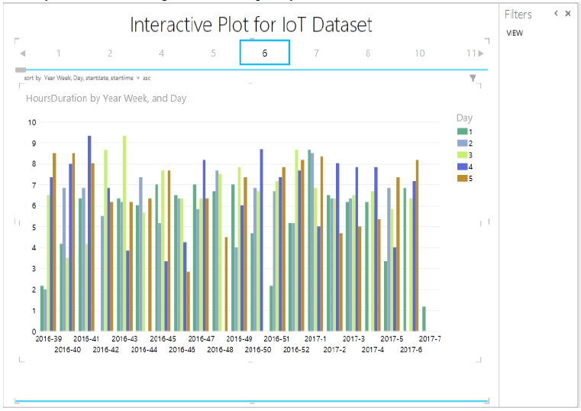
Analysis and Implementation
Step 3:
  Manual analysis using Microsoft Power View.

Slide 9
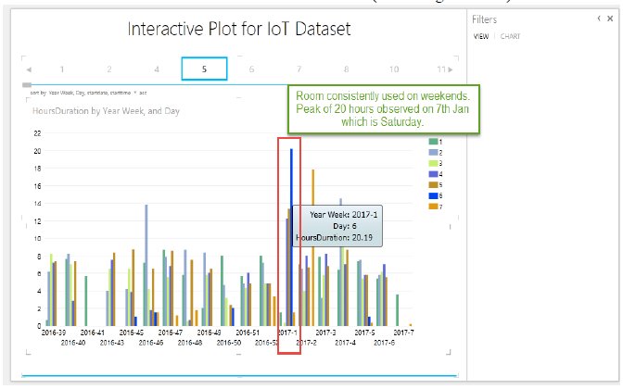
Analysis and Implementation

Slide 10
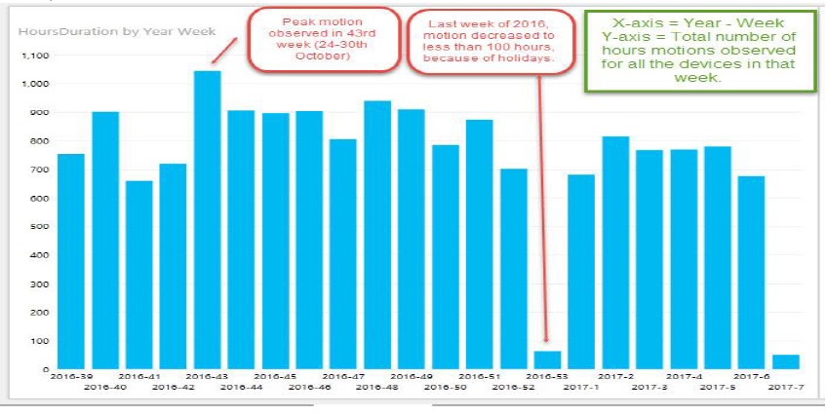
Analysis and Implementation

Slide 11
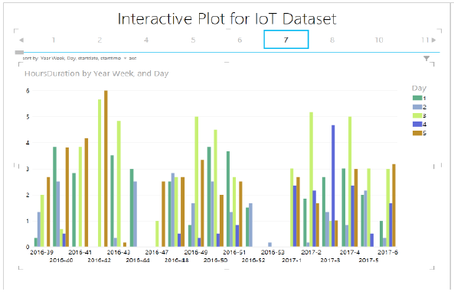
Analysis and Implementation
Seems like a staff room because of consistent usage of 7 hours on working hours.
Dip was observed between 12 – 1 PM. (may be because of lunch hours)

Slide 12
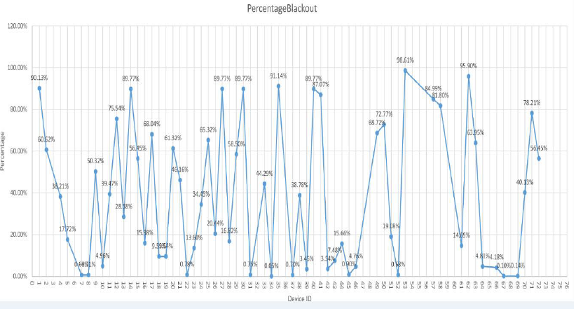
Analysis and Implementation
Step 4:
Used machine learning to identify similarity between rooms.
Removed blackout values from the data.
Normalized timestamps of all devices to make the feature vector of same length.

Slide 13
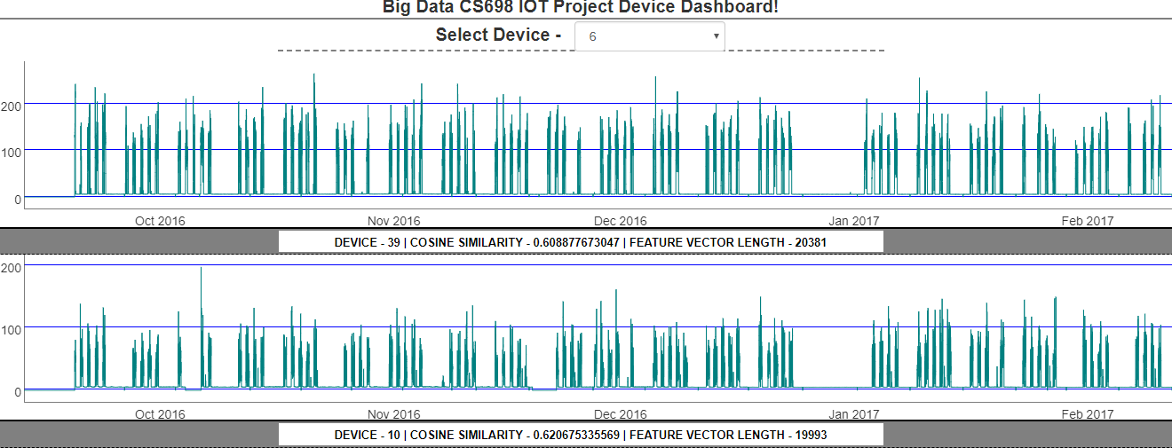
Dashboard
Device Similarity: To visualize cosine similarity amongst devices
https://parul3067.github.io/DashBoard-Device.html

Slide 14
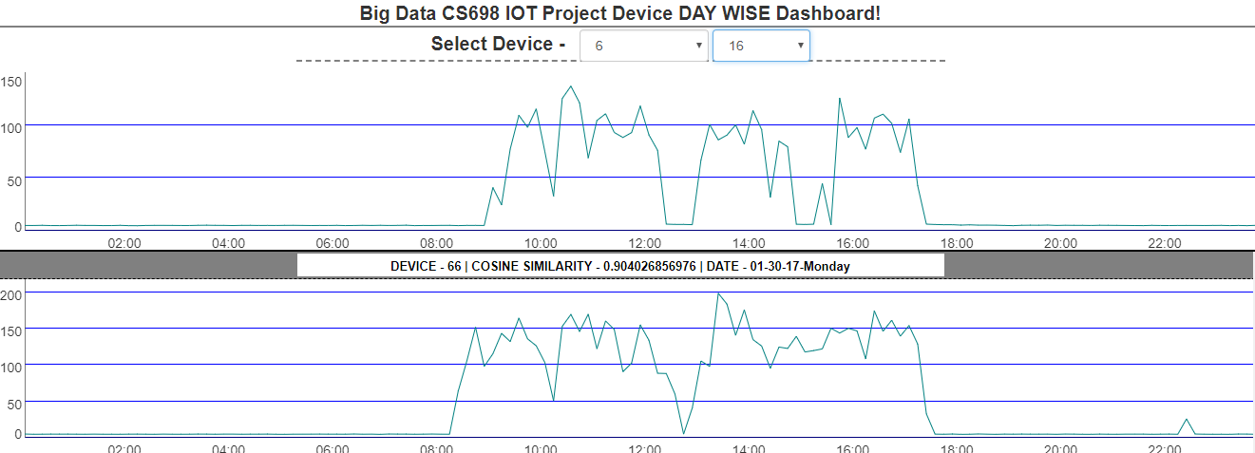
Dashboard
Day wise Device Similarity: To visualize cosine similarity of a certain day and device with other devices and days.
https://parul3067.github.io/DashBoard-Day.html

Slide 15
Thanks!

